Slide 1
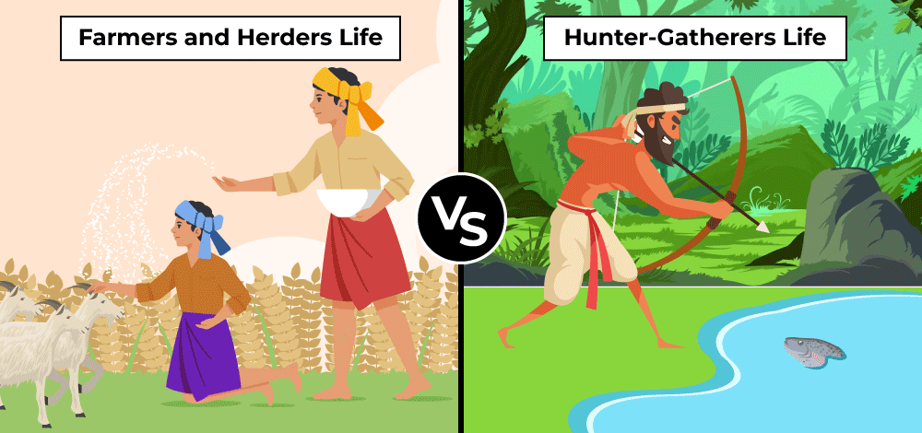
Focus: Was the transition to an agricultural society truly a step forward for mankind?
9/23 Monday- Guns Germs and Steel; Yali’s Question

Slide 2
Activity 1: Research/Preparation (~15 Mins.)
DIRECTIONS: You can use your devices to help research, but all notes must be taken in your notebook and devices will be put away when we commence the debate.
STEP 1: Your table will be assigned: Hunter/Gatherer or Agriculturalist.
STEP 2: Create a T-Chart in your notebook for your topic that lists the advantages and disadvantages of your topic’s way of life.
STEP 3: One student will create an opening statement ~(three sentences) that outlines the overall position and strengths of their group.
STEP 4: One student will be responsible for highlighting and attacking the issues of the other group.
STEP 5: (Counterclaim) One student will be responsible for predicting the opponent’s potential attacks. Prepare responses to these attacks.
Consider both short term and long term effects!

Slide 3

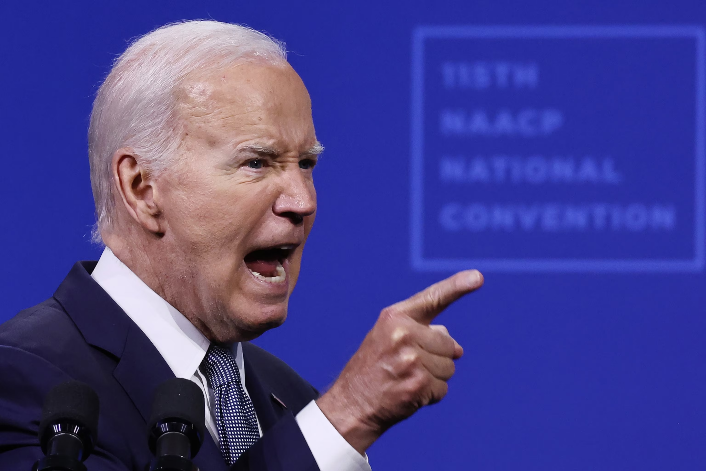

Slide 4


